Slide 1

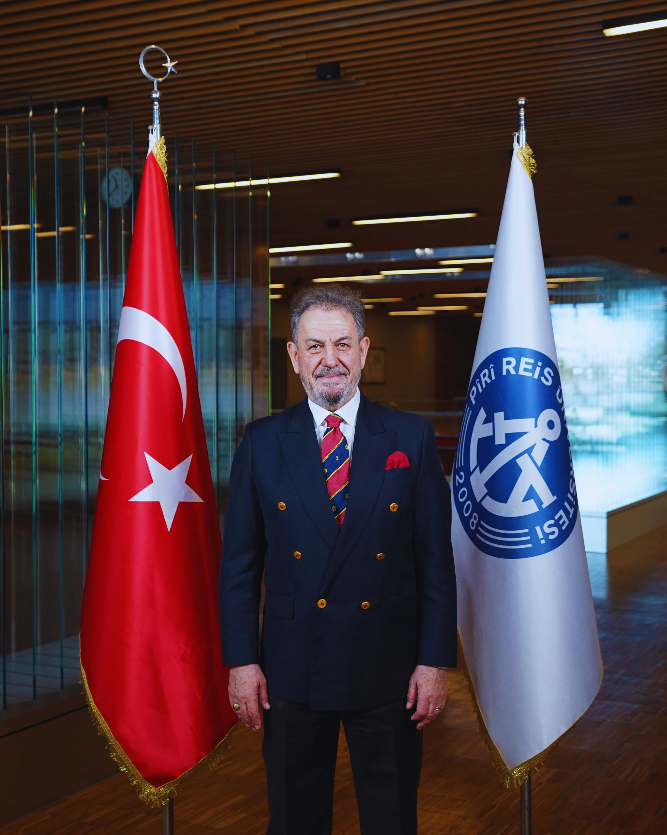
KEYNOTE SPEAKER
Prof. Dr. MUSTAFA TANER ALBAYRAK
MARITIME BUSINESS MANAGEMENT DEPARTMENT, FACULTY OF ECONOMICS AND ADMINISTRATIVE SCIENCES, PIRI REIS UNIVERSITY
SUDEMAR – SUSTAINABLE DEVELOPMENT OF THE EUROPEAN MARITIME SECTOR
SECTION I SHIPPING AND PORTS
INTERNATIONAL COOPERATION DELIVERS TANGIBLE RESULTS
FOR THE MARITIME INDUSTRY
12th International Maritime Congress, 13-14 May 2026

Slide 2

INTERNATIONAL COOPERATION DELIVERS TANGIBLE RESULTS
FOR THE MARITIME INDUSTRY
International cooperation is no longer optional for the maritime sector—
it is essential
- Cross-border projects deliver value beyond the traditional blue economy
- These initiatives support global frameworks and drive transformation
across maritime-related sectors
- International cooperation strengthens resilience, accelerates innovation,
and prepares the sector for future challenges.
12th International Maritime Congress, 13-14 May 2026

Slide 3
Beyond the Traditional Blue Economy
The blue economy was often understood in relatively narrow terms:
fisheries, shipping, ports, shipbuilding, and marine tourism.
Cooperative maritime projects—designed around sea-basins and shared maritime borders—reach far beyond coastal waters.
They integrate transport corridors, energy systems, digital infrastructure, environmental protection, workforce development, and regional innovation ecosystems.
12th International Maritime Congress, 13-14 May 2026

Slide 4
Beyond the Traditional Blue Economy
As a result, their impact extends well inland:
Ports become logistics and energy hubs for entire regions
Maritime decarbonization drives innovation in manufacturing, hydrogen
production, and smart grids
Marine data and digitalization support research, climate modelling, and
risk management far beyond the shoreline
Maritime cooperation not only an ocean strategy but also
a comprehensive socioeconomic development strategy
12th International Maritime Congress, 13-14 May 2026

Slide 5
Sea-Basin Cooperation:
From Shared Challenges to Shared
Solutions
Sea basins—whether the Mediterranean, the Black Sea, the Baltic, the North
Sea, or beyond
— share environmental conditions, transport routes, and risk profiles and vulnerabilities
Cooperative projects rooted in these realities:
Reflect local maritime ecosystems, rather than one-size-fits-all approaches
Align public authorities, industry, research institutions, and civil society
Enable trust-building and long-term planning across borders.
Joint maritime spatial planning to balance shipping, offshore energy, fisheries, and
conservation
Cross-border port cooperation to reduce emissions, optimize traffic flows, and enhance
safety
Collaborative monitoring of marine pollution and ecosystem health through shared data
platforms.
12th International Maritime Congress, 13-14 May 2026

Slide 6
Supporting Global and UN-Led Initiatives
The United Nations Sustainable Development Goals, particularly
SDG 13 (Climate Action), SDG 14 (Life Below Water), and SDG 9 (Industry,
Innovation and Infrastructure)
The UN Decade of Ocean Science for Sustainable Development, by
improving marine knowledge, data sharing, and decision-making
International Maritime Organization goals, including decarbonization, safety,
and environmental protection
What makes these projects powerful is that they do not operate in isolation.
They bridge global ambition with regional implementation, turning policy
frameworks into operational outcomes.
12th International Maritime Congress, 13-14 May 2026

Slide 7
Driving Transformation Across Maritime-Related Sectors
The maritime sector is undergoing a profound transformation:
Decarbonization is no longer a future goal—it is a present obligation
Digitalization is redefining navigation, logistics, and port operations
Workforce skills must evolve as technologies and regulations change
International cooperation accelerates this transformation through joint pilot projects, shared
testbeds, and coordinated investment. Partners can:
De-risk innovation and scale new technologies faster;
Harmonize standards and procedures, reducing barriers for industry;
Encourage knowledge transfer between advanced and emerging maritime regions
I
Innovation thrives where collaboration exists—and maritime innovation is strongest when it
connects ports, vessels, researchers, energy providers, and regulators across borders.
12th International Maritime Congress, 13-14 May 2026

Slide 8
Strengthening Resilience in the Face of Climate Change
Climate change represents one of the greatest systemic risks to the maritime sector:
Sea-level rise threatens port infrastructure
Extreme weather disrupts shipping and global logistics
Ocean warming and acidification impact fisheries and coastal communities
No single country, port, or company can address these risks alone
Cross-border maritime projects strengthen resilience by:
Developing joint risk assessments and adaptation strategies;
Sharing early-warning systems and climate data;
Coordinating investments in nature-based solutions, resilient infrastructure, and emergency response
Maritime sector remains safe, reliable, and resilient—even under
increasingly uncertain conditions.
12th International Maritime Congress, 13-14 May 2026

Slide 9
People, Skills, and the Next Generation
Cooperation in the maritime domain is not only about infrastructure and technology,
it is about people
Many successful projects invest heavily in:
Training programs and capacity building
Mobility and exchange of maritime professionals
Engaging young people and future leaders in ocean and maritime careers
This human dimension is essential. A sustainable maritime future depends on a workforce
that is skilled, adaptable, and internationally connected.
12th International Maritime Congress, 13-14 May 2026

Slide 10
Conclusion: Cooperation as a Strategic Asset
International maritime cooperation delivers tangible results. It delivers
economic value, environmental protection, social cohesion, and strategic resilience.
In a time of global uncertainty, cooperation in the maritime sector sends a powerful
message:
Shared oceans demand shared responsibility
Innovation grows stronger through partnership. The maritime industry, working together,
can be a driving force for a sustainable and prosperous future
Let us continue to invest in cooperation—not as a cost, but as a strategic asset.
12th International Maritime Congress, 13-14 May 2026

Slide 11
PROJECTS
https://sudemar.eu/
https://greenportalliance.eu/
https://digitalhygieneatsea.eu
12th International Maritime Congress, 13-14 May 2026

Slide 12
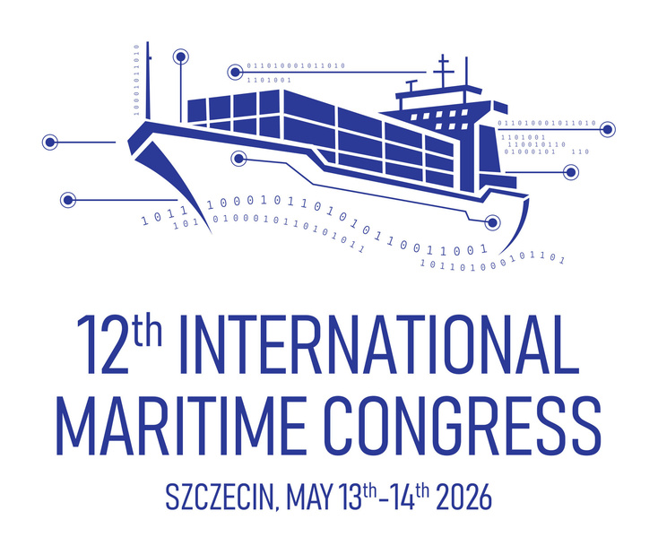
12th International Maritime Congress, 13-14 May 2026
SZCZECIN, POLAND
THANK YOU
FOR YOUR ATTENTION
KEYNOTE SPEAKER
Prof.Dr. Capt.
MUSTAFA TANER ALBAYRAK
MARITIME BUSINESS MANAGEMENT DEPARTMENT, FACULTY OF ECONOMICS AND ADMINISTRATIVE SCIENCES, PIRI REIS UNIVERSITY
SUDEMAR – SUSTAINABLE DEVELOPMENT OF THE EUROPEAN MARITIME SECTOR
talbayrak@pirireis.edu.tr

