Slide 1




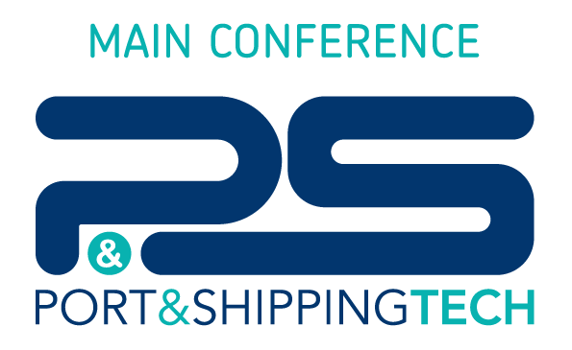

Behavioural Changes for Greener Ports:
i principali risultati del progetto europeo GREENPORT Alliances
NAPLES SHIPPING WEEK 2026
Naples, 29 October 2026

Slide 2

Agenda
THE PROJECT
              Challenges, objectives and partners
FROM NEEDS TO EDUCATIONAL MATERIAL
WP2, WP3 and WP4 learning streams
THE HUMAN FACTOR
WP5 simulator study at the Antwerp Maritime Academy
IMPACT ASSESSMENT AND MAIN RESULTS
Notes:
Here is the outline of the presentation.
I will start with the project, its challenges, objectives and partners, and with how the work is organised.
Then I will show how we moved from the needs analysis and best practices to the educational material, and present new evidence on the human factor in fuel consumption from the simulator study carried out in Work Package 5.
I will close with the evaluation framework and the main results.

Slide 3
Challenges & Objectives
Challenges
Objectives
Emission reduction and climate impact from port operations.
Limited green skills in existing curricula.
Urgent need for behavioural change in operations.
Develop innovative green curricula for Higher Education and Vocational Education and Training.
Foster academia–industry knowledge exchange.
Drive behavioural change through training and awareness.
Enhance skills for the green transition.
Promote innovation and collaboration across the sector.

Slide 4
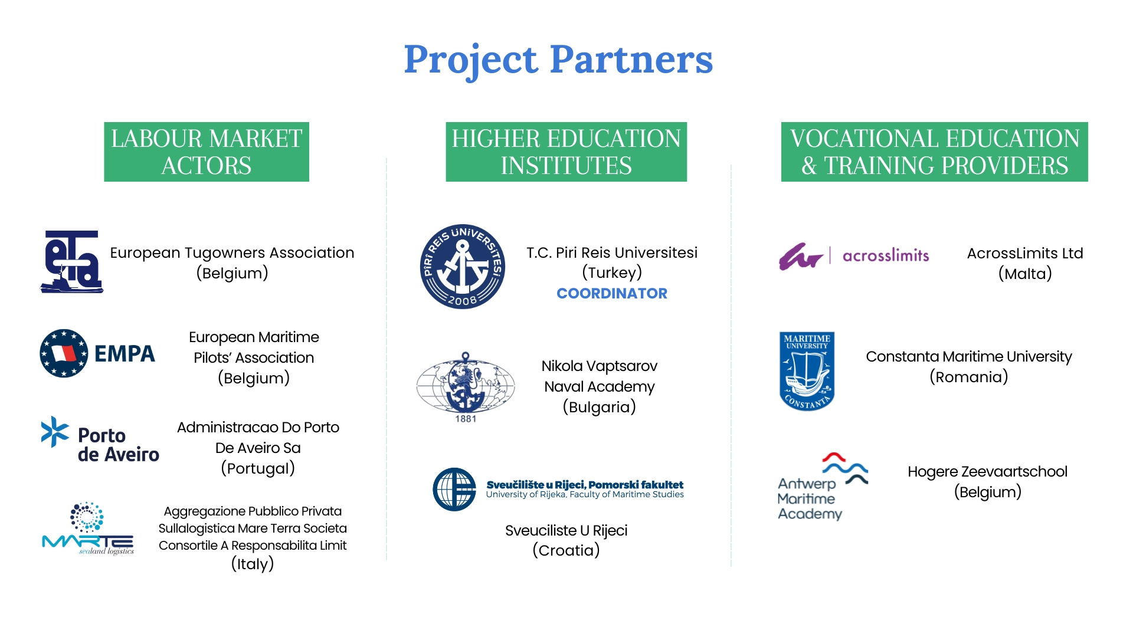
Project Partners
LABOUR MARKET
ACTORS
HIGHER EDUCATION
INSTITUTES
VOCATIONAL EDUCATION
& TRAINING PROVIDERS
European Tugowners Association
(Belgium)
T.C. Piri Reis Üniversitesi
(Turkey)
COORDINATOR
AcrossLimits Ltd
(Malta)
European Maritime
Pilots’ Association
(Belgium)
Nikola Vaptsarov
Naval Academy
(Bulgaria)
Constanta Maritime University
(Romania)
Administração do Porto
de Aveiro, SA
(Portugal)
Hogere Zeevaartschool
(Belgium)
Aggregazione Pubblico Privata sulla Logistica Mare Terra Società Consortile a Responsabilità Limitata
(Italy)
Sveučilište u Rijeci
(Croatia)

Slide 5


The Work Plan
WP 1: Project Management & Quality Assurance
WP 2
Needs analysis and commercial drivers
WP 3
Analysis of raw data for curriculum development
WP 4
Development of educational material
WP 5
Piloting, evaluation & curriculum impact analysis
HE Learning Stream
HE Piloting
VET Learning Stream
VET Piloting
Train-the-trainer (TTT) Learning Stream
Train-the-trainer (TTT) Piloting
WP 6: Dissemination & Impact

Slide 6
Possible Pathways to Reduce Emissions
Strategies to improve energy efficiency in port services
1
Disruptive new technologies
2
Gradual technical improvements
3
Change human behaviour
LONG TERM
MEDIUM TERM
IMMEDIATE
E-fuels, hydrogen and full electrification: essential, but they need years, new infrastructure and major investment.
Retrofits, hybrid and battery systems, drop-in biofuels such as HVO: they bridge the transition, including temporary solutions.
Better human-machine interaction: same vessel, same task, less fuel. No new technology or capital investment needed.
Faster impact, lower investment
GREENPORT focus: consume less energy by improving human-machine interaction, starting today on the existing fleet.
Notes:
There are three ways to cut energy use and emissions in port services.
Disruptive new technologies such as e-fuels, hydrogen and full electrification are essential, but they take years and require new infrastructure and major investment.
Gradual technical improvements, such as retrofits, hybrid systems and drop-in biofuels like HVO, can bridge the transition.
The third pathway is immediate: changing human behaviour.
With better human-machine interaction, the same vessel can perform the same task with less fuel, without new technology.
This is where GREENPORT focuses: consuming less energy by improving how people operate the vessels we already have.

Slide 7
Agenda
THE PROJECT
              Challenges, objectives and partners
FROM NEEDS TO EDUCATIONAL MATERIAL
WP2, WP3 and WP4 learning streams
THE HUMAN FACTOR
WP5 simulator study at the Antwerp Maritime Academy
IMPACT ASSESSMENT AND MAIN RESULTS

Slide 8

WP2 – Needs Analysis
Surveys of industry and academia, literature review and research on incentives
70
towage industry responses (ETA)
26
pilot responses (EMPA)
76
academic responses (Piri Reis University)
Industry needs
Academia
Training is wanted but scarce: over 90% see a lack of “green” courses
Sustainability principles must be integrated into maritime curricula
Speed, planning and coordination are the main sources of avoidable fuel use
Educators need more training, resources and teaching materials
Safety must remain the priority and cannot be traded for emission cuts
Behavioural change is seen as effective, but it is hard to teach
Key finding: awareness of the need to decarbonise is high, but it does not translate into daily practice. Behavioural change is the lever.
Notes:
The results from the towage industry questionnaire, the pilots' survey, and the academic survey demonstrate a strong general awareness of the need to decarbonise and improve environmental standards within the maritime sector.
However, this awareness does not consistently translate into practical daily efforts and behaviours to reduce environmental impact.
Behavioural change is seen as a beneficial tool to enhance sustainability, though motivating learners to adopt these changes poses challenges due to resistance, lack of expertise, and insufficient resources.
In conclusion, while there is a strong sectoral and academic commitment to reducing emissions and improving environmental standards, significant gaps in training, resources, and practical application must be addressed to effectively achieve these goals, while not compromising the overall mission of tugs and pilots, which is safety, security and protection of the environment.

Slide 9

WP3 – Analysis of Raw Data
Industry report on best practices and case studies, coordinated by MAR.TE.
1
What we collected
2
How we grouped the practices
3
What the case studies showed
17
validated best practices
Emission reduction
biofuels, eco-friendly propulsion, monitoring and maintenance
Which operational areas need behavioural training
Which factors affect emissions:
18
case studies
Operational efficiency
optimised speed and routes, real-time data, simulation of manoeuvres
Weather
Tide
Waiting times
Port-area features
9
contributing partners
Engagement and professional development
continuous training, behavioural change, collaboration between ports
Onshore power supply
OUTPUT FOR WP4
Training needs grouped as:
Technical
Operational
Regulatory
Notes:
In WP3, coordinated by MAR.TE., the partners identified and validated 17 best practices for sustainable port services, supported by 18 case studies contributed by nine partners.
The practices cover three areas: emission reduction, operational efficiency, and engagement and professional development.
The case studies helped us identify which operational areas require behavioural training and which factors affect emissions, such as weather, tide, the specific features of the port area, the availability of onshore power supply and waiting times.
The resulting training needs, grouped as technical, operational and regulatory, became the evidence base for the curricula developed in WP4.

Slide 10

WP4 – Development of Educational Material
From evidence to curricula for three learning streams
WP2
WP3
WP4
WP5
Needs analysis
Best practices
Curriculum design
Piloting and evaluation
Surveys and literature define skills gaps and training needs
17 practices and 18 case studies translated into training needs
Learning outcomes, syllabi and materials built on the COM-B behavioural model
Courses tested with students, professionals and trainers, then revised
Design principles: COM-B behavioural model, real case studies, simulator practice and blended learning, across higher education (HEI), vocational training (VET) and train-the-trainer (TTT).
Notes:
Based on these findings, we developed the educational material in WP4.
The process followed four steps: the needs analysis of WP2, the best practices and case studies of WP3, the design of learning outcomes, syllabi and materials, and finally piloting and evaluation in WP5.
All courses are built on the COM-B behavioural model and combine real case studies, simulator practice and blended learning, across three learning streams: higher education, vocational training and train-the-trainer.

Slide 11
WP4 – Three Learning Streams
Three target groups, one behavioural approach
HEI
VET
TTT
Higher Education
Vocational Education and Training
Train-the-Trainer
For: future managers, pilots and harbour masters
Format: 14-week course, 28 hours, 4 ECTS, blended learning
Focus: sustainability in navigation and port management
For: practising pilots and tug masters
Format: intensive two-day course
Focus: regulations, fuels and energy saving, then simulator practice with debriefing
For: educators and trainers of both streams
Format: online e-learning programme with certificate
Focus: preparing trainers to deliver the HEI and VET courses
One maritime education ecosystem: all three streams share the COM-B behavioural approach.
Notes:
GREENPORT delivers its training through three integrated learning streams.
The higher education stream is a 14-week university course of 4 ECTS, in blended format, for future managers, pilots and harbour masters, linking sustainability with navigation, port operations and management.
The vocational stream is an intensive two-day course for practising pilots and tug masters: the first day covers regulations, alternative fuels and energy-saving strategies, the second day is spent on the simulator practising eco-navigation scenarios, followed by debriefing.
The train-the-trainer stream is an online programme that prepares educators to deliver both courses and certifies them on completion.
All three share the same behavioural approach, based on the COM-B model.

Slide 12
Agenda
THE PROJECT
              Challenges, objectives and partners
FROM NEEDS TO EDUCATIONAL MATERIAL
WP2, WP3 and WP4 learning streams
THE HUMAN FACTOR
WP5 simulator study at the Antwerp Maritime Academy
IMPACT ASSESSMENT AND MAIN RESULTS

Slide 13

WP5 – First Test: Human Factor and Fuel Use
WP5 bridge-simulator study at the Antwerp Maritime Academy within GREENPORT Alliances
21
Participants
3.6x
highest vs. best fuel-consumption rate for the same manoeuvre (+260%)
Tug masters, pilots, dock pilots and other maritime professionals, sailing in their normal style with no instruction to save fuel
20 min
Identical scenario
Same twin-screw harbour tug, weather and task for every run: approach and port-side mooring in Bodø (Norway)
1 Hz
Second-by-second data
Rudder and RPM orders, actual RPM, engine power, fuel rate and vessel motion logged throughout each run
Notes:
To test how much the human factor really matters, the Antwerp Maritime Academy ran a controlled bridge-simulator experiment within Work Package 5 of GREENPORT.
21 participants — tug masters, pilots, dock pilots and other maritime professionals — performed exactly the same task with the same twin-screw harbour tug, the same starting position and the same weather: an approach and port-side mooring in the port of Bodø, lasting about twenty minutes.
They were not asked to save fuel; they simply sailed as they normally would, while the simulator logged commands, RPM, engine power, fuel rate and vessel motion every second.
The result was striking: the most fuel-intensive run consumed fuel at 3.6 times the rate of the best run — 221 versus 62 kilograms per hour, a gap of about 260 percent.
Same vessel, same task, same conditions: the difference comes from how the vessel was handled.

Slide 14
WP5 – A Three-Level Diagnostic Framework
The same simulator data read at three levels of detail
1
Relative benchmark
2
Fuel-rate distribution
3
RPM micro-events
How far is each run from the best one?
When and where does fuel use peak?
Which command patterns drive fuel use?
Fuel use per hour of manoeuvre, compared with the best observed run (62 kg/h).
A personal threshold isolates each participant's peak moments of fuel use and maps them onto the route.
Ordered vs. actual RPM shows frequent changes, ahead–astern reversals and new orders before the engine responds.
Gap from 0% to 260%
Peak time: 5% vs. 43%
Fragmented vs. stable command rhythm
No clear link with professional background: the spread lies between individuals.
Notes:
To understand where this difference comes from, the same data were analysed at three levels.
Level 1 is a simple benchmark: each run is compared with the best observed run, giving gaps from zero to 260 percent.
Level 2 looks inside each run: the second-by-second fuel rate is turned into a distribution, and a personal threshold isolates the high-consumption moments.
One participant spent only 5 percent of the manoeuvre above their threshold, another 43 percent, and these moments can be shown on the route for debriefing.
Level 3 compares ordered and actual engine RPM: the least efficient patterns show frequent changes, ahead–astern reversals and new orders given before the engine has responded.
Importantly, there was no clear link with professional background: the spread lies between individuals, not between professions.

Slide 15
WP5 – Why It Matters: Costs, Emissions and Training
An immediately implementable measure for ships already in service
From diagnosis to training
€5,540
Personalised debriefing on the route sections where each operator's fuel use peaked
extra fuel and emissions cost per operating day, highest vs. best run
Simulator training on command timing: fewer reversals, time for the engine to respond, earlier anticipation of the final approach
CO₂ 1,290 t
Feedback and decision-support tools that make fuel use visible to bridge teams
No capital investment: applicable now to the existing fleet, alongside new fuels and technologies
and €582,000 over 105 operating days, in an illustrative scenario
Scenario based on the simulator results (fuel €1,200/t; emissions cost €245.20/t of fuel); the benchmark is the best observed run, not a theoretical optimum. Source: O. Schalm, J. Lemmens, L. De Wilde, Antwerp Maritime Academy (forthcoming).
Notes:
Why does this matter?
Translated into an illustrative scenario, the difference between the highest and the best run is worth 5,540 euros per operating day, or 582,000 euros and 1,290 tonnes of CO2 over 105 operating days.
These are scenario figures, not predictions, but they show the order of magnitude.
The good news is that this lever requires no new fuels and no capital investment: personalised debriefing, simulator training on command timing, and feedback or decision-support tools can be applied today to the existing fleet.
This is exactly the approach behind the GREENPORT training streams.

Slide 16
WP5 – The Second Test: Before and After
VET pilot course: the same simulator manoeuvre, repeated after eco-navigation training
1
Run 1
Usual style
BETWEEN THE TWO RUNS
Eco-navigation
training
Route planning
Communication and teamwork
Anticipating manoeuvres
Steady, optimal use of power
2
Run 2
Eco-navigation
Port entry and berthing performed as usual, without applying eco-navigation principles.
The same manoeuvre repeated with careful route planning and optimal energy use.
WHAT STAYS
THE SAME
Same vessel
Same simulator
Same weather
Same task
No new technology
Indicators compared: fuel consumption, CO₂, NO_{x} and SO₂ emissions, power profile.
Notes:
The first test showed how much the human factor matters: with the same vessel and the same task, fuel use varies widely from one operator to another.
In the second test, carried out within the VET pilot course, we checked whether training can reduce this gap.
Participants first performed the port entry and berthing in their usual style, without applying eco-navigation principles.
After the training, they repeated the same manoeuvre with careful route planning and optimal energy use.
The vessel, simulator, weather conditions and operational task stayed the same, and no new technology was introduced: only the way the manoeuvre was conducted changed, meaning planning, communication and anticipation.
We compared fuel consumption, CO2, NOx and SO2 emissions and the power profile.
The results are on the next slide.

Slide 17
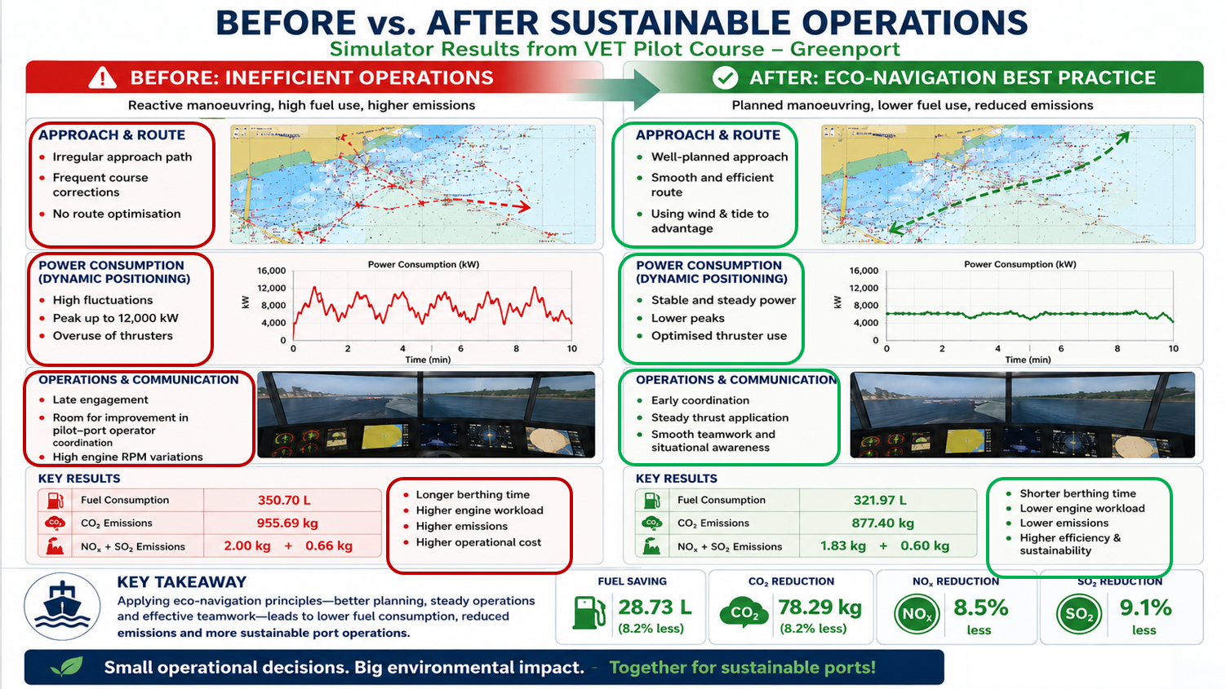
Notes:
Participants first executed the port entry and berthing without applying eco-navigation principles.
Participants repeated the same manoeuvre with careful route planning and optimal energy use.
What is particularly interesting is that we did not introduce any new technology between these two scenarios.
The vessel, simulator, weather conditions, and operational task remained essentially the same.
The main difference was planning, communication, anticipation, and the application of eco-navigation principles.
This demonstrates that sustainability improvements are often achievable through operational practice, not only through capital investment.

Slide 18
Agenda
THE PROJECT
              Challenges, objectives and partners
FROM NEEDS TO EDUCATIONAL MATERIAL
WP2, WP3 and WP4 learning streams
THE HUMAN FACTOR
WP5 simulator study at the Antwerp Maritime Academy
IMPACT ASSESSMENT AND MAIN RESULTS

Slide 19
Evaluation: From Questions to Evidence
Four evaluation criteria, each answered with data from the project
1
Relevance
2
Effectiveness
Does the training meet real port-industry needs?
Do operators change how they handle the vessel?
Evidence: built on 172 survey responses and 17 validated best practices
Evidence: VET pilot > same manoeuvre, –8.2% fuel and CO₂ after the training
3
Efficiency
4
Sustainability
Are time and resources well used?
Will the methods continue beyond the project?
Evidence: short formats (two-day VET, online TTT) on existing vessels and simulators
Evidence: certified trainers and an e-learning platform let partners keep delivering the courses
Notes:
We evaluated the project against four criteria.
Relevance: the training was designed on 172 survey responses from the towage industry, pilots and academia, and on 17 validated best practices.
Effectiveness: in the VET pilot, participants repeated the same manoeuvre after eco-navigation training and used 8.2 percent less fuel, with the same reduction in CO2.
Efficiency: the courses use short formats, a two-day VET course and an online train-the-trainer programme, on existing vessels and simulators, with no new technology.
Sustainability: certified trainers and the e-learning platform allow partners to keep delivering the courses after the project.

Slide 20
Key Results and Take-Home Message
What GREENPORT delivers, in four numbers
17
3
3.6x
–8.2%
validated best practices, documented by 18 case studies
integrated learning streams: HEI, VET and Train-the-Trainer
gap in hourly fuel use between operators, same vessel and task
fuel and CO₂ in the same manoeuvre after eco-navigation training (VET pilot)
TAKE-HOME MESSAGE
Behavioural change is a decarbonisation lever that ports can use today: same vessels, same tasks, less fuel.
Courses and training materials: www.greenportalliance.eu
Notes:
To sum up: 17 validated best practices documented by 18 case studies, three integrated learning streams, a 3.6-times gap in fuel-consumption rate between operators handling the same vessel, and an 8.2 percent reduction in fuel and CO2 after eco-navigation training in the VET pilot.
The take-home message is simple: behavioural change is a decarbonisation lever that ports can use today, with the same vessels and the same tasks, using less fuel.

Slide 21



Thank you for your attention
Marco Ferretti
Full Professor of Business Economics and Management
Parthenope University of Naples
President of MAR.TE. S.c.ar.l.
E-mail: marco.ferretti@uniparthenope.it
Phone: +39 335 5889237
info@greenportalliance.eu www.greenportalliance.eu
greenportalliances greenport-alliances greenport.alliances
Disclaimer:
This project has been funded with support from the European Commission. This publication reflects the views only of the author, and the Commission cannot be held responsible for any use which may be made of the information contained therein.

